Slide 1

AI Shell capabilities
Connect you with Copilot in Azure directly in your CLI
Integrated and ease of us in your CLI
Extensibility platform

Slide 2
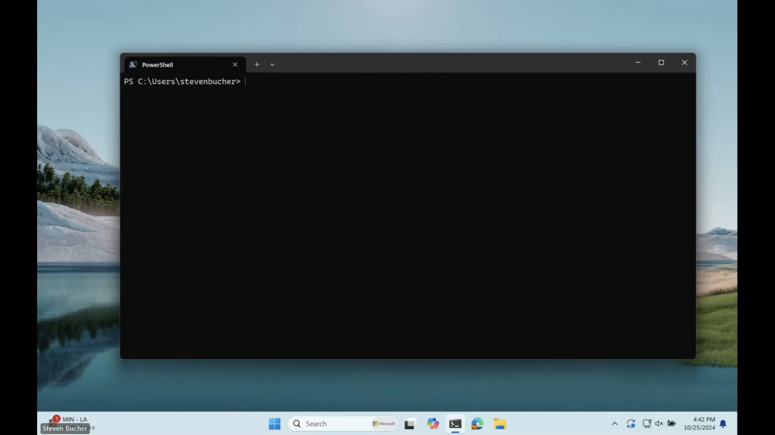

Slide 3

Learn more about AI Shell

